Slide 1

Facebook Ad Targeting
Hadi Toamah
Daniel Hammond
Matijs Eraly
Cédric Van Riet
Thomas Villers
Shafiq Pohesh

Slide 2

Data Collection
FB collects:
Demographic info
Interests & Behaviour
Activity
Via user interaction
Not limited to FB
Notes:
Facebook collects a vast amount of data on its users, including demographic information, interests, behaviors, and online activity. This data is gathered from user interactions on Facebook, Instagram, and other platforms owned by Facebook, as well as from third-party sources.

Slide 3
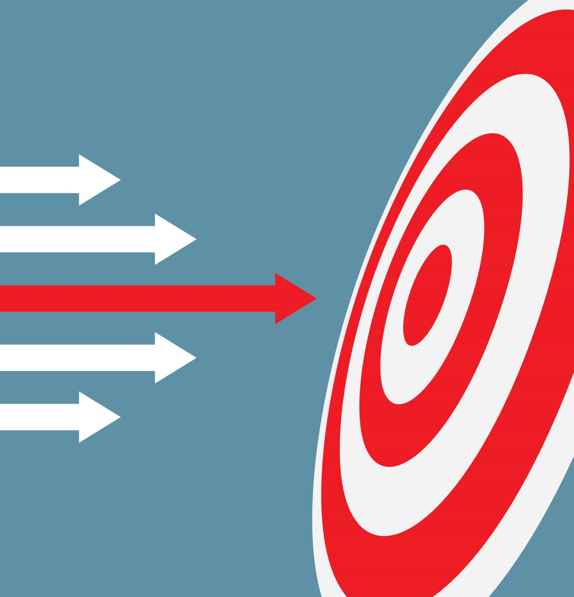
Ad Targeting Options
Fb ads manager is used by advertisers
Gives advertisers user info automatically
Notes:
Advertisers can use Facebook's Ads Manager to select specific criteria that define their target audience.
This can include factors like age, gender, location, interests, online behavior, and more.

Slide 4

Auction-based System
Ad space is based on highest bid
CPM (cost per impression)
CPC (cost per click)
Notes:
When you create an ad campaign, you bid on the cost per impression (CPM) or cost per click (CPC) you're willing to pay for your ads to be shown to your target audience.
This is done in an auction-based system, where advertisers compete for ad space.

Slide 5

Relevance Score
Notes:
Facebook assesses the relevance of your ad to the target audience you've selected.
If your ad is deemed relevant and likely to generate engagement, it's more likely to be shown.

Slide 6

Ad Placement Algorithm
Ad placement depends on target demographic info
Notes:
Facebook uses an algorithm to determine the best placement for your ad based on factors like user behavior, device type, and location. This means your ad might appear in different places depending on who is viewing it.

Slide 7

Ad Frequency and Rotation
Not overwhelmingly
Minimum rotation
Different types of ads
Notes:
Facebook aims to show users a variety of content, so it manages how frequently
your ad is shown to a single user to avoid overwhelming them with the same content.

Slide 8

Learning Phase
Testing on data folds
Helps optimize the delivery over time
Notes:
When you start a new campaign, Facebook goes through a learning phase where it gathers data on
how your ad performs with different segments of your target audience. This helps it optimize the delivery of your ad over time.

Slide 9
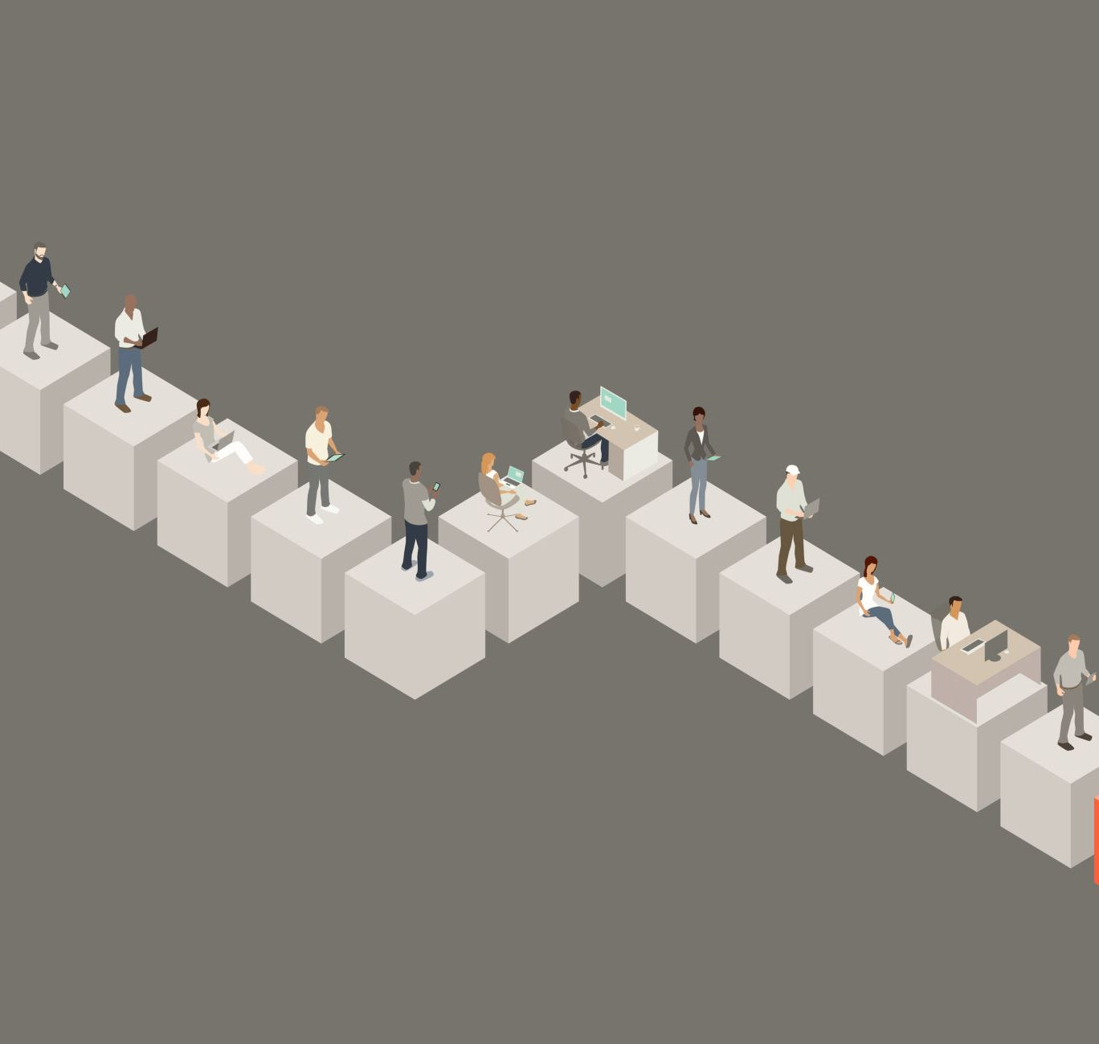
Lookalike Audiences
Generalisation using “lookalike audiences”
Allows people to meet people who share the same inter
Notes:
Facebook can also create "lookalike audiences" based on characteristics of your existing customers. This allows you to reach people who are similar to your current customer base.

Slide 10
Retargeting
Fb pixel used to track behaviour across multiple sites
Redirects people who’ve interacted with you before
Notes:
You can also use Facebook's retargeting capabilities to show ads to people who have interacted with your website or app. This is done through the Facebook Pixel, which tracks user behavior.

Slide 11

Ad Feedback and Reporting
User option to mark ads as not relevant
Allows FB to change strategies
Notes:
Users can provide feedback on ads they see, which can impact ad performance. Additionally, advertisers have access to detailed reporting on ad performance, allowing them to adjust their strategies.

Slide 12
Challenges / Goals for FB
Satisfy both users & advertisers
Relevancy
Use data responsable
Stay in lines of the policies
Ethical questions
Notes:
It's important to note that Facebook's algorithms are designed to balance the interests of both users and advertisers. Users are shown ads that are likely to be relevant to them, while advertisers have the tools to reach their target audience effectively.
However, it's crucial for advertisers to handle user data responsibly and comply with Facebook's policies to ensure privacy and ethical advertising practices

